Slide 1
Saqib Gulam Hussain Shaikh
Top Instagram Influencers Dashboard
Introduction:
Hi! I made this Instagram Influencer Dashboard in Power BI with the data set I have been provided by Unified Mentors.
The main idea of this project is to study how different Instagram influencers perform on the platform and what makes them more popular than others. The dataset has information about influencers such as their followers, number of posts, total likes, average likes, engagement rate, and their overall influence score. These details can help us understand how much impact an influencer can create among their audience.
The goal of this Power BI project is to analyze Instagram influencer data across different countries and users, by using metrics such as followers, likes, engagement rate, and influence score. By looking at these metrics, we can see patterns like which influencers are most followed, which ones get more likes on new posts, and how active they are compared to others.
This study will help us get a clearer picture of the growth of influencers on Instagram.

Slide 2
Problem Statement:
The dataset provided to us contains information about the top Instagram influencers, such as their followers, posts, average likes, engagement rate, and influence score. However, the raw data by itself does not give us a clear picture. To make sense of it, we need to clean, organize, and analyze the data properly.
The problem we are trying to solve in this project is:
How do we identify the most impactful influencers?
What patterns can we find in their engagement levels?
How do influencers from different countries perform compared to others?
Can this analysis give useful insights for marketing strategies?
By using Power BI, we can transform this dataset into a dashboard that highlights KPIs like total followers, average likes, and engagement trends. This will help us to understand the growth, reach, and influence of top Instagram personalities in a more meaningful way.

Slide 3
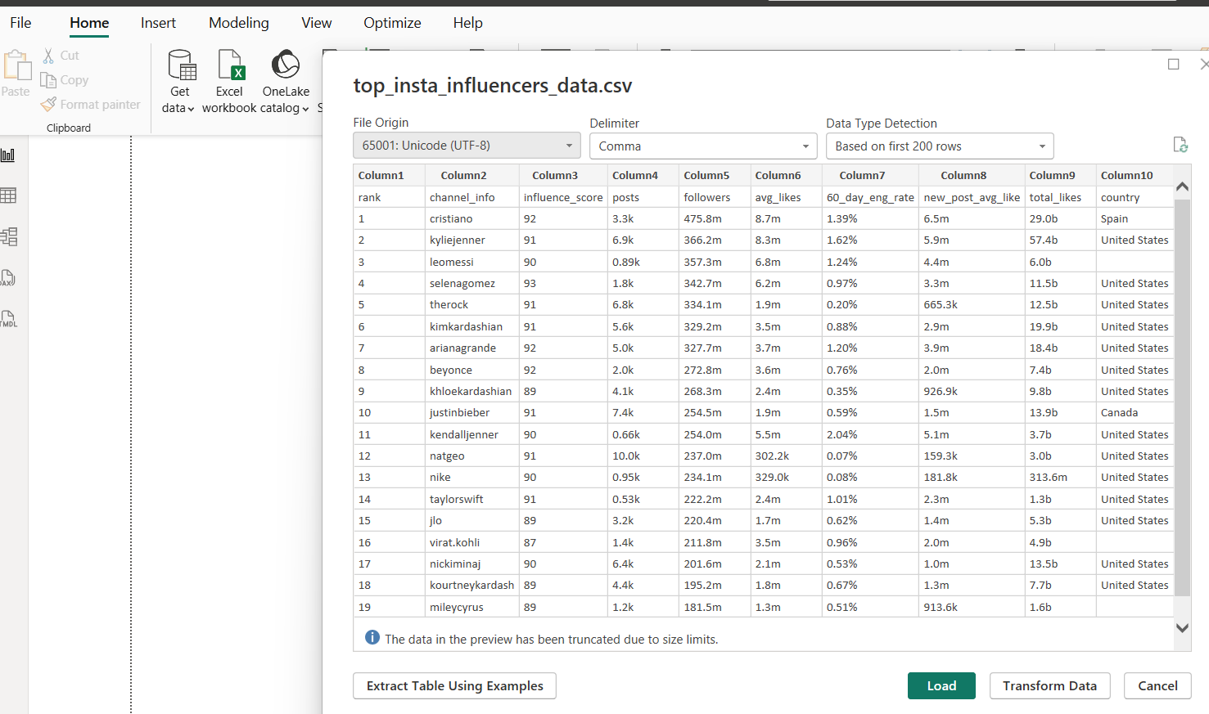
Task 1: Data Import and Preparation
Connect to Data: Importing Data
After importing the dataset into Power Bl. Here I’ve used the first row as a header option to sort out the headers for each row:
As we can see, there are some discrepancy in the data as: The Data Type for all the Columns have been set as (Text). However before changing the Data type, We actually need to change the Data Itself, As Columns like: (posts, followers, avg_likes, new_post_avg_likes & total_likes) have decimals and text data all mixed in together.

Slide 4
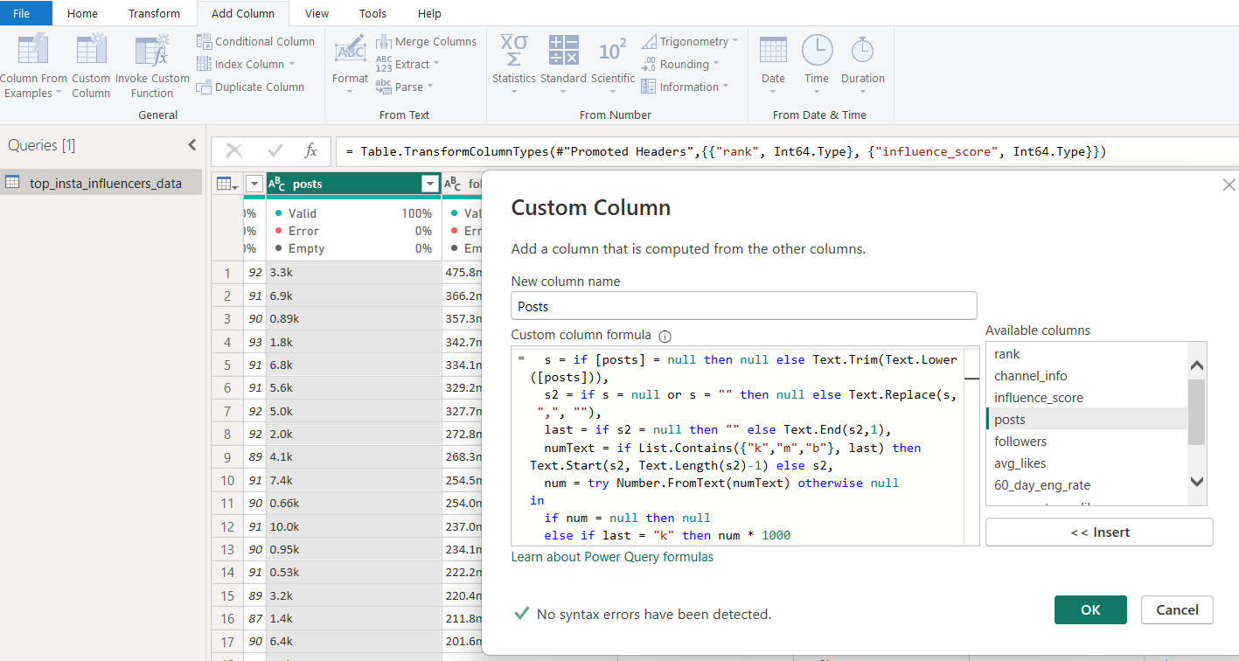
Data cleansing
Process of cleaning the Data:
As Columns like: (posts, followers, avg_likes, new_post_avg_likes & total_likes) have decimals and text data like (k,m,b) all mixed in together, Here we can multiply all the values of k with 1000, Or any values of m with 1000000 and for the value of b with 1000000000.
So, Here I’ve created a single code which we can run in a custom column based on the original Columns and their values.
let
s = if [original column name] = null then null else Text.Trim(Text.Lower([original column name])),
s2 = if s = null or s = "" then null else Text.Replace(s, ",", ""),
last = if s2 = null then "" else Text.End(s2,1),
numText = if List.Contains({"k","m","b"}, last) then Text.Start(s2, Text.Length(s2)-1) else s2,
num = try Number.FromText(numText) otherwise null
in
if num = null then null
else if last = "k" then num * 1000
else if last = "m" then num * 1000000
else if last = "b" then num * 1000000000
else num
Repeating the same Steps for other Columns : ( followers, avg_likes, new_post_avg_likes & total_likes)

Slide 5
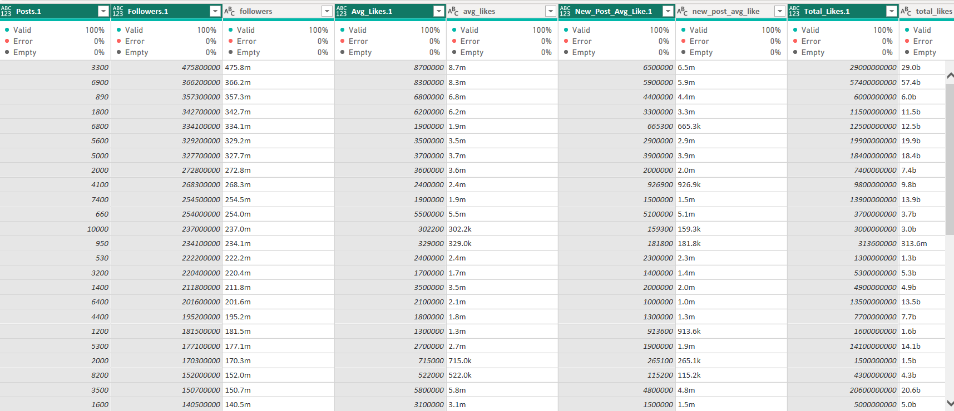
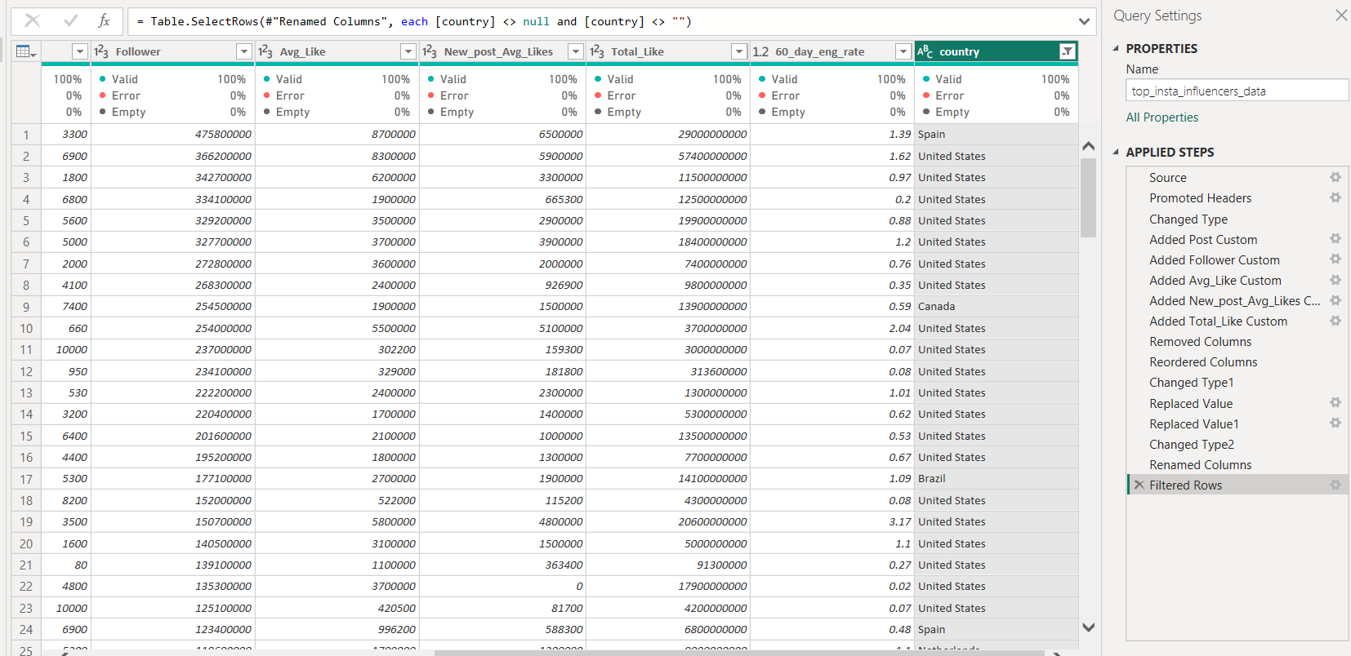
By repeating the same steps, I’ve successfully cleaned the Data
Next, I’ve changed the Data Types of all these calculated columns to Whole Numbers. Deleting the Original Columns, And Renaming our New Calculated Columns.
Also, Removed the Error from the 60_day_eng_rate column and replaced it with blank (as null)
And Lastly, Removing any data where the Country shows Null or Empty as that is an important Column required for the Analysis.
With this I’ve cleaned and prepared all the Data ☺

Slide 6
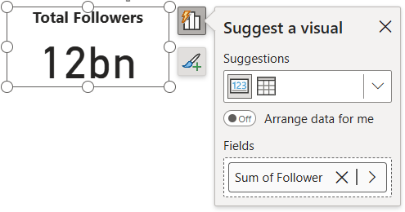
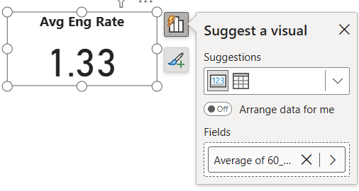
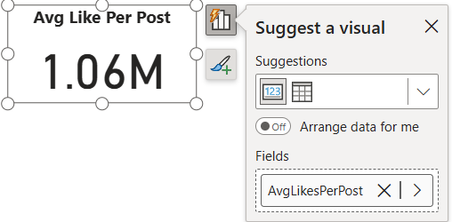
Step 2: Defining Key Performance Indicators (KPIs)
KPIs will measure influencer performance and engagement.
1. Total Followers: Sum of followers across all influencers. (Also Formatted And Added Title)
2. Average Engagement Rate: The average 60_day_eng_rate.
3. Average Likes per Post: Calculated by total_likes / posts:
For this KPI: I am going to create a new Measure which divides the total likes of influencers by their total posts
So the Formula I’ve used is : AvgLikesPerPost = DIVIDE(SUM('top_insta_influencers_data'[Total_Like]), SUM('top_insta_influencers_data'[Posts])) Formula in simple = Total_Like ÷ posts.

Slide 7
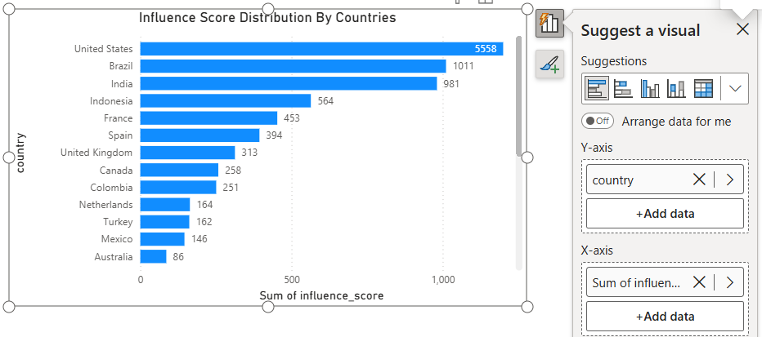
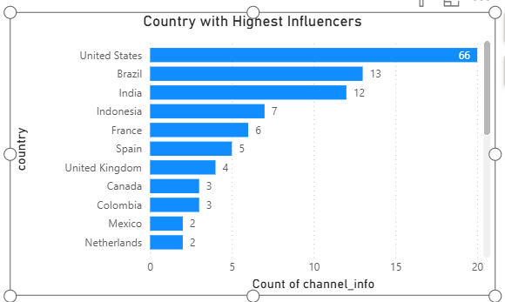
4. Influence Score Distribution: Distribution analysis of influence_score
across countries or ranks.
5. Country with Highest Influencers: A count of influencers by country to
determine top regions.

Slide 8
Step 3: Creating Calculated Fields :
The next step as per the guide is to Create Calculated Fields:
1. Engagement Rate (ER) Calculation:
Formula: ([avg_likes] / [followers]) * 100
Hence, Created a new Column:
EngagementRate = DIVIDE('top_insta_influencers_data'[Avg_Like], 'top_insta_influencers_data'[Follower]) * 100
2. Growth Rate in New Post Likes:
Formula: ([new_post_avg_like] - [avg_likes]) / [avg_likes] * 100
Created a new Column:
GrowthRateNewPosts = DIVIDE(('top_insta_influencers_data'[New_post_Avg_Likes] - 'top_insta_influencers_data'[Avg_Like]), 'top_insta_influencers_data'[Avg_Like]) * 100
3. Like-to-Follower Ratio:
Formula: [total_likes] / [followers]
Created a new Column:
LikeToFollowerRatio = DIVIDE('top_insta_influencers_data'[Total_Like], 'top_insta_influencers_data'[Follower])

Slide 9
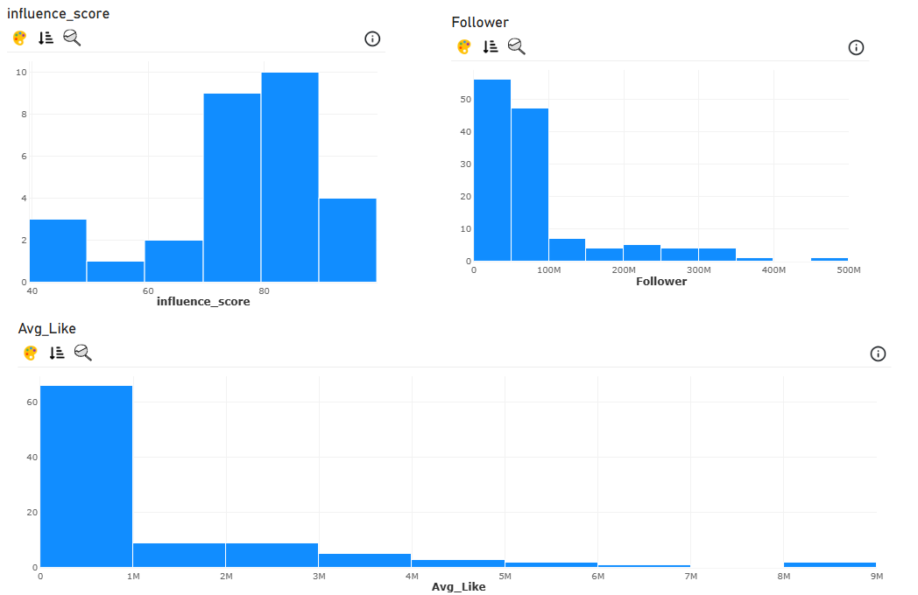
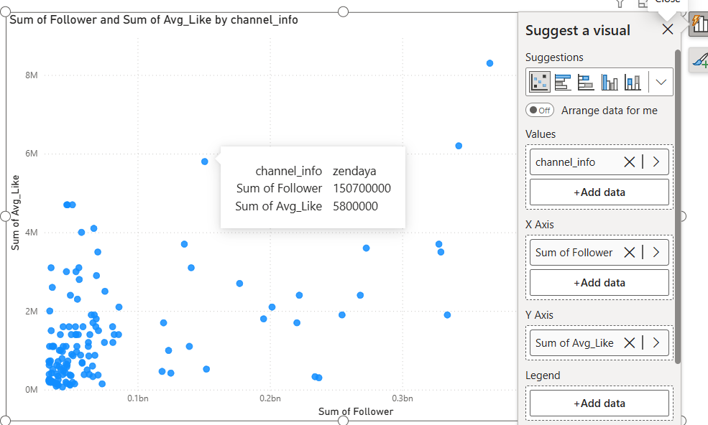
Step 4: Exploratory Data Analysis (EDA)
1. Distribution Analysis:
Using the histogram for influence_score, followers, and avg_likes to understand the spread and outliers.
Created a scatter plot for followers vs. avg_likes to see if there’s a correlation between follower size and average likes.

Slide 10
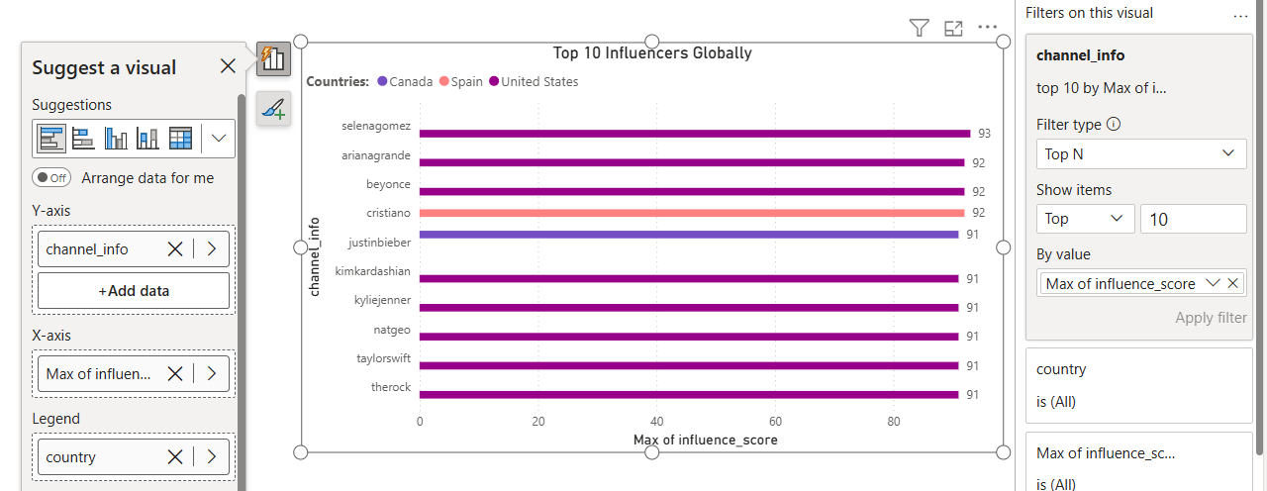
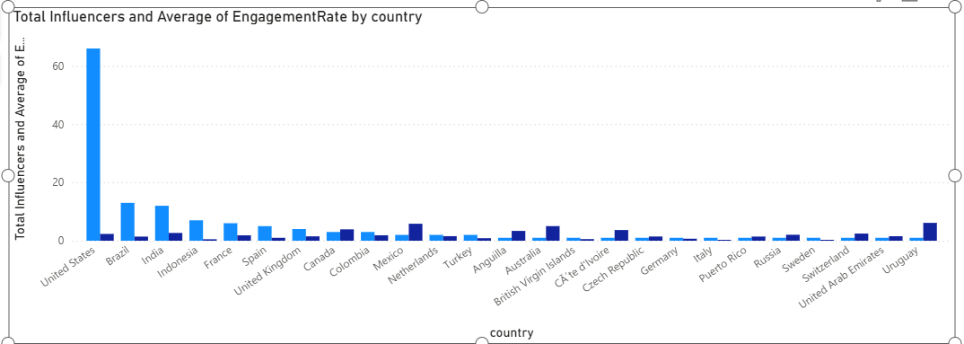
2. Top 10 Influencers:
Rank influencers based on influence score and show the top 10 for each country or globally:
Here I’ve added a bar chart and added channel info to Y axis, Influence score to X axis, And Country to Legend by adding a TOP N filter to the chart.
3. Country-wise Analysis:
Created a bar chart by country showing the total number of influencers
and average engagement rate per country.

Slide 11
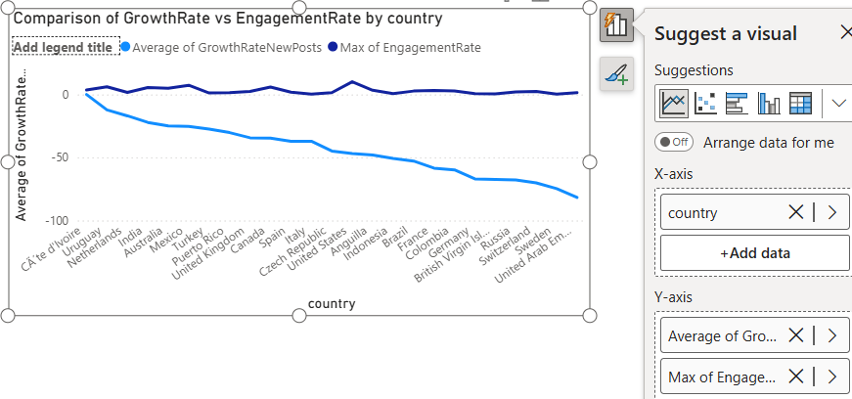
4. Trend Analysis for New Post Likes:
Created a Line chart showing the average new_post_avg_like over time to see engagement trends.
This chart shows the fall of Like Rates on the new Posts, compared to the previous EngagementRate by each countries.

Slide 12
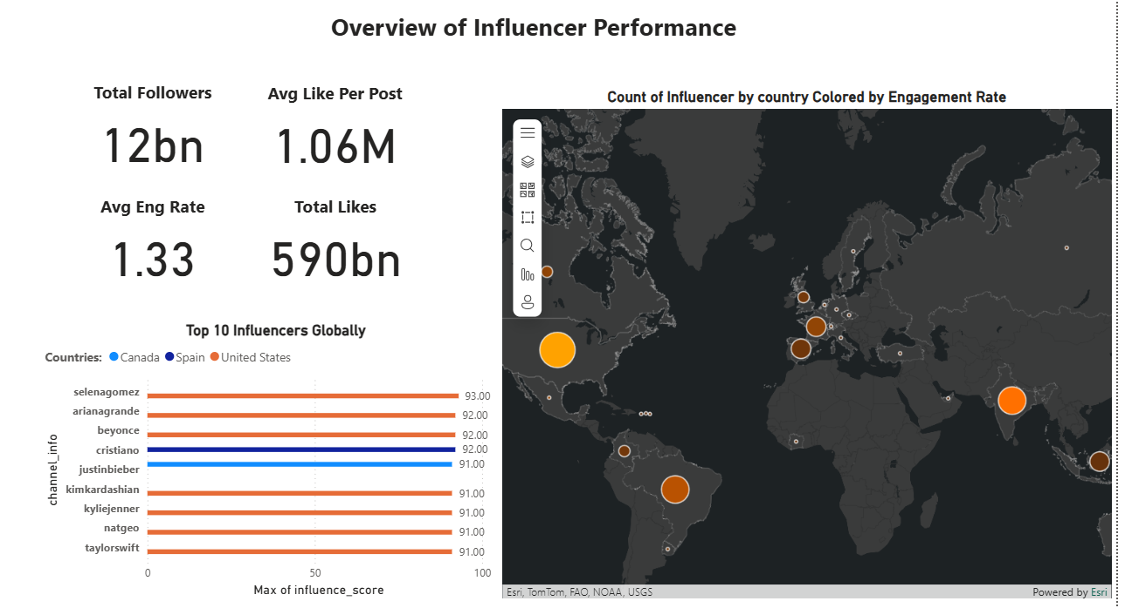
The Final Dashboard
Final Dashboard Consists of 6 Pages:
1: Overview of Influencer Performance
2: Engagement and Influence Metrics
3: Country-Specific Insights
4: Engagement Trends
5: Additional Visualizations
Step 5: Data Visualization and Dashboard Design
Designing dashboards will provide a visually rich summary of influencer insights.
Dashboard 1: Overview of Influencer Performance
○ KPI Tiles: Display the key metrics, including total followers, average
engagement rate, and total likes.
○ Bar Chart: Top 10 influencers based on influence_score with rank
labels.
○ Map Visualization: Geographic distribution of influencers by country,
color-coded by the average engagement rate.

Slide 13
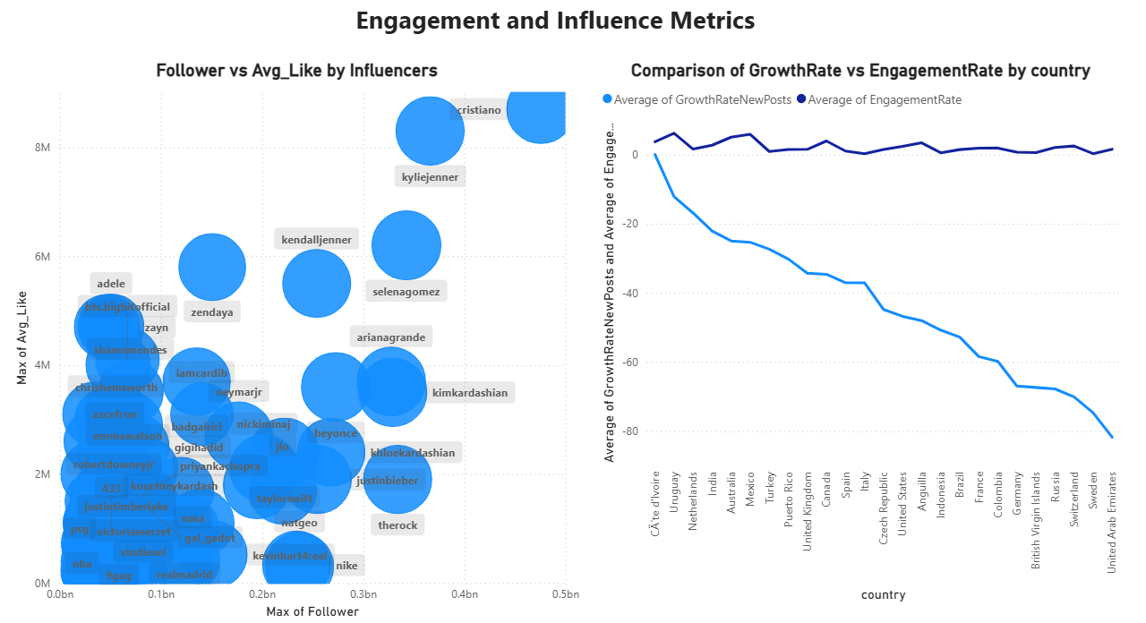
Dashboard 2: Engagement and Influence Metrics
○ Scatter Plot: followers vs. avg_likes with influence_score as a
size dimension to understand the influence-power relationship.
○ Line Chart: Time-based trends in new_post_avg_like, with filters to
select specific countries or influencers.

Slide 14
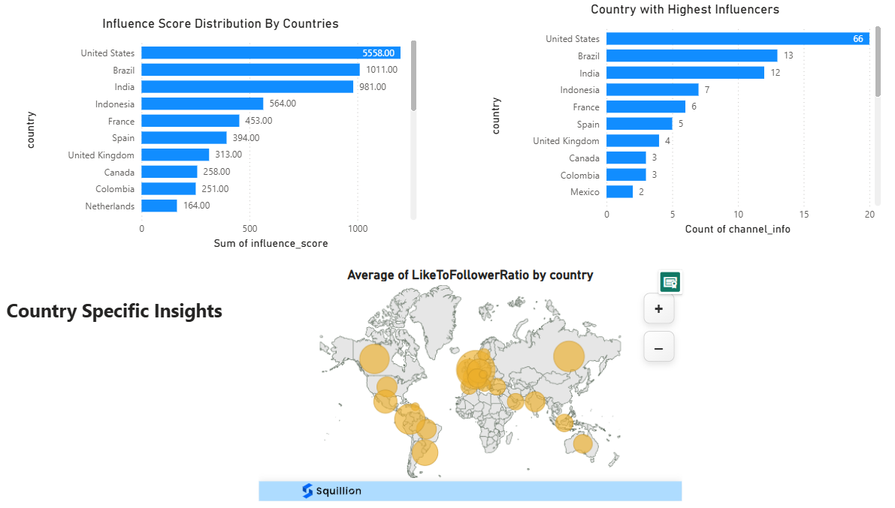
Dashboard 3: Country-Specific Insights
○ Bar Chart: Total influencers and average influence_score per
country.
○ Bubble Chart: Show influencers' like-to-follower ratio by
country for a quick view of regional influence.

Slide 15
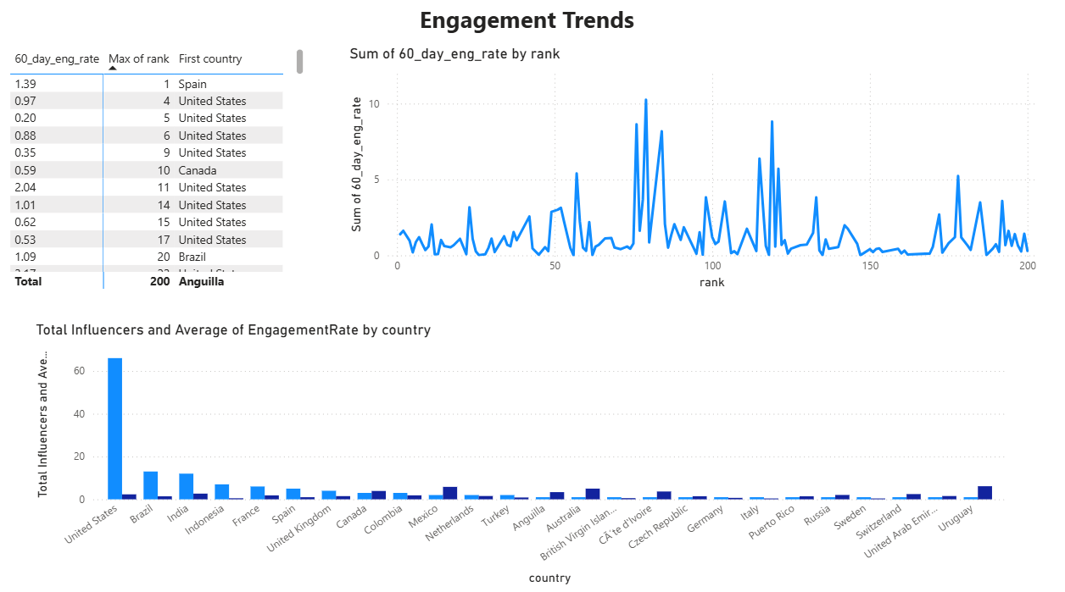
Dashboard 4: Engagement Trends
○ Heatmap: Display 60_day_eng_rate by influencer rank and country,
useful for spotting high-engagement influencers.
○ Trendline: Plotting changes in engagement rates across ranks or
countries over time.

Slide 16
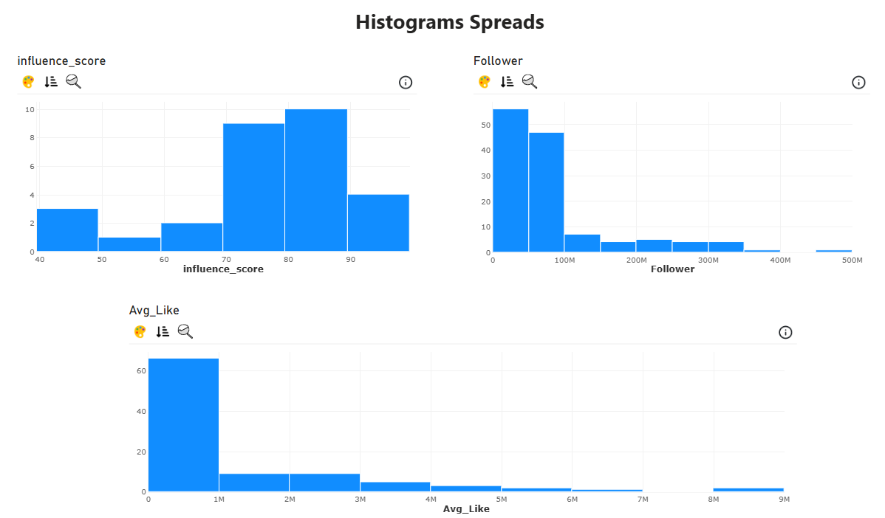
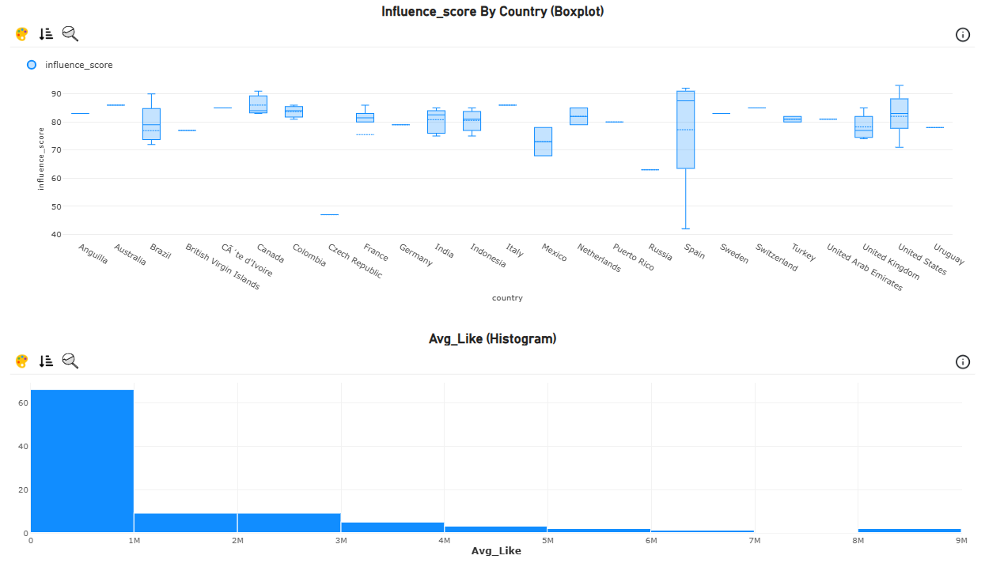
Dashboard 5: Distribution Analysis:
○ Use histograms for influence_score, followers, and avg_likes to
understand the spread and outliers.
Dashboard 6: Additional Visualizations
● Boxplot for influence_score distribution per country to understand variance.
● Histogram for avg_likes to see typical engagement patterns across influencers.

Slide 17
Charts that answers the findings/ Results of Problem Statement:
1) How do we identify the most impactful influencers?
Top 10 Influencers Globally (Bar Chart) – shows highest influence scores.
KPI cards (Total Followers, Avg Likes, Total Likes, Avg Eng Rate)
Follower vs Avg_Like (Bubble Chart.
2) What patterns can we find in their engagement levels?
Engagement Trends (Line chart: 60_day_eng_rate vs rank).
Histograms (Influence Score, Followers, Avg Likes).
Boxplot of Influence Score by Country.
Avg Like vs Follower Ratio by Country (Map).
3) How do influencers from different countries perform compared to others?
Influence Score Distribution by Countries (Bar chart).
Country with Highest Influencers (Bar chart).
World Map (Count of Influencers by country, colored by Engagement Rate).
Comparison of GrowthRate vs EngagementRate by Country (Line chart).
Total Influencers and Avg Engagement Rate by Country (Bar chart).
4) Can this analysis give useful insights for marketing strategies?
All KPI cards + Top 10 influencers list.
Country-specific insights maps (Like-to-Follower Ratio, Influence Score Distribution).
GrowthRate vs EngagementRate line chart.
Histograms & Boxplots – help marketers understand spread (avoid outliers, pick consistent performers).
Thank You

